Slide 1


Lesson 2
What is Turtle?

Slide 2
Learning Objectives
By the end of this lesson, you will…
Understand how to use EduBlocks
Understand how a sequence of code works
Understand how to use different loops to repeat a sequence

Slide 3
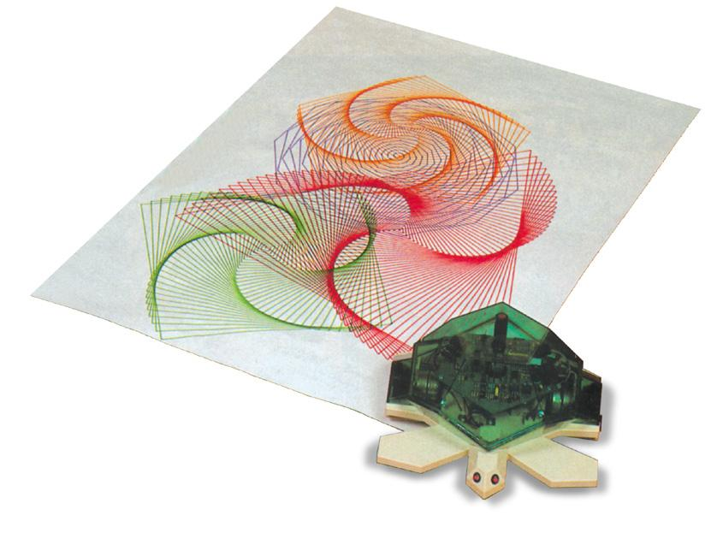
Lesson 2
What is Turtle?
Turtle is a way to draw with Python
Turtle was introduces in 1967 via a language called “Logo”

Slide 4
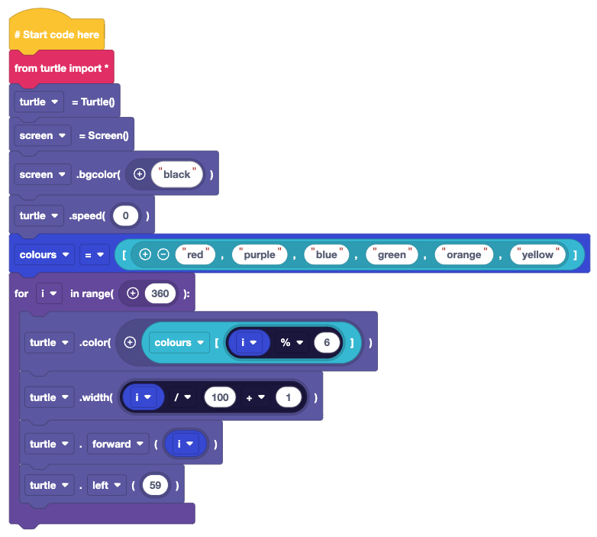
Lesson 2
Turtle is a great introduction
Remember the coding concepts?
Using Turtle we can understand:
How a sequence of code works
How to use loops to repeat a sequence
How to calculate angles to draw shapes

Slide 5
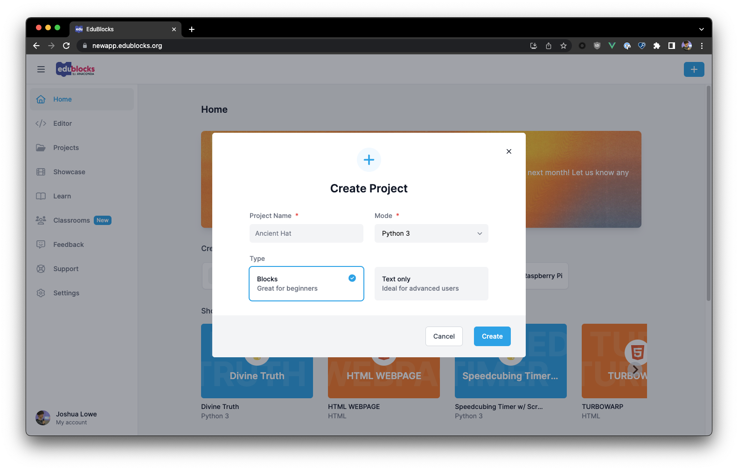
Lesson 2
Getting Started
Open a browser
Go to app.edublocks.org/editor
Select a mode
We’ll be using Python, so select “Python 3”
Get started!
Rename your project to “Lesson 2” and click Create!

Slide 6


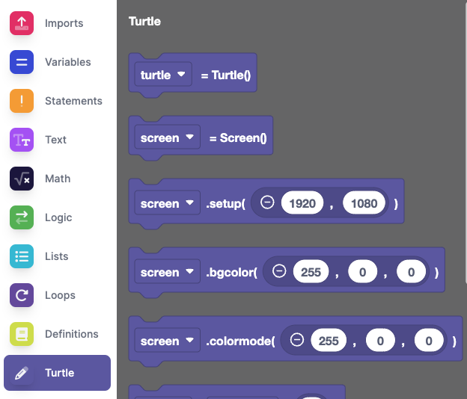
Lesson 2
Using Turtle
To use Turtle we need to find the blocks
In order to use Turtle we need to import it, this can be found in Imports
All the blocks for using Turtle can be found under the Turtle section.

Slide 7
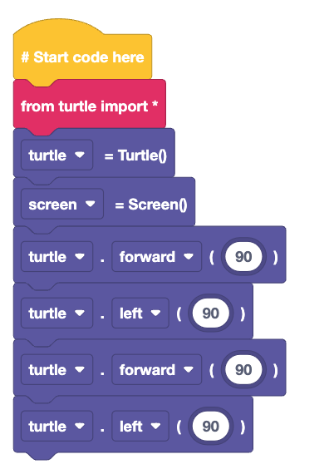

Lesson 2
Drawing a shape
Create the code on the right
Click to see what happens.
Can you finish the code to draw a square?

Slide 8
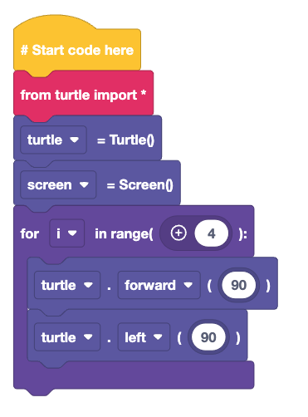
Lesson 2
Can we improve the code?
Using a for loop, we can see the number of times that our loop will iterate
This type of loop has definite iteration
Have you noticed the left turn value is 90?
What does that mean?

Slide 9
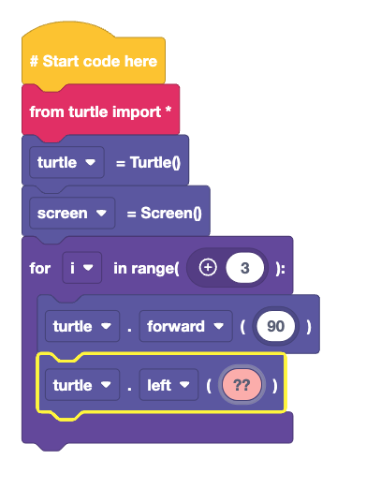
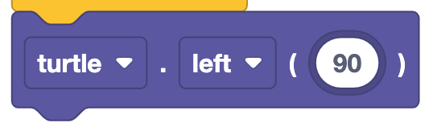
Lesson 2
Can we draw a triangle?
The turning angle
Is set by dividing 360 by the number of sides a shape has
For example a square has 4 sides
360/4 = 90
So, how do we draw a triangle?

Slide 10
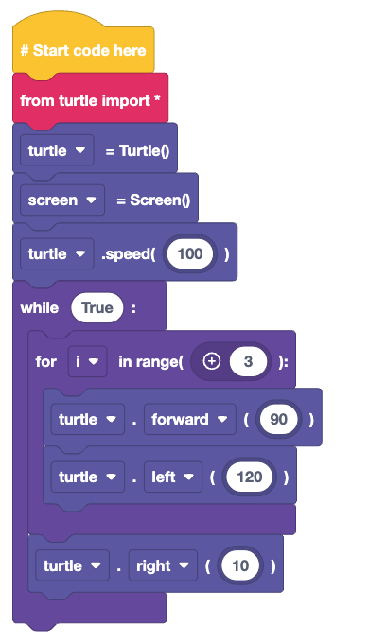
Lesson 2
Drawing patterns
Patterns are repeating sequences of code
Here we modify the triangle code to draw a repeating, rotating pattern.
The while True loop will run forever and the for loop with draw the triangle
Each time the loop iterates, we move the Turtle 10 pixels

Slide 11
Lesson 2
Drawing patterns

Slide 12
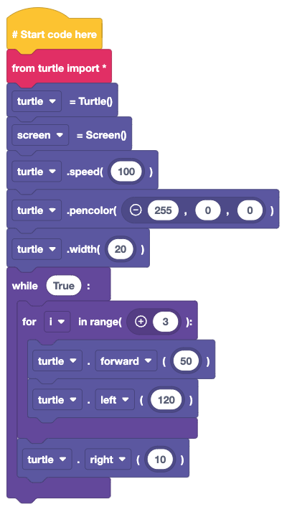
Lesson 2
Changing Colour
The colour and thickness of the “pen” can be changed
Colours are mixed using RGB values.
Values start at 0 and end at 255
Red is 255,0,0
Green is 0,255,0
Blue is 0,0,255
Thickness is called ”width”

Slide 13
Lesson 2
Challenge: Design a pattern
Can you create a pattern using Turtle?
Your pattern should repeat a shape
The pen should change colour at least once
The width of the pen should change at least once

Slide 14
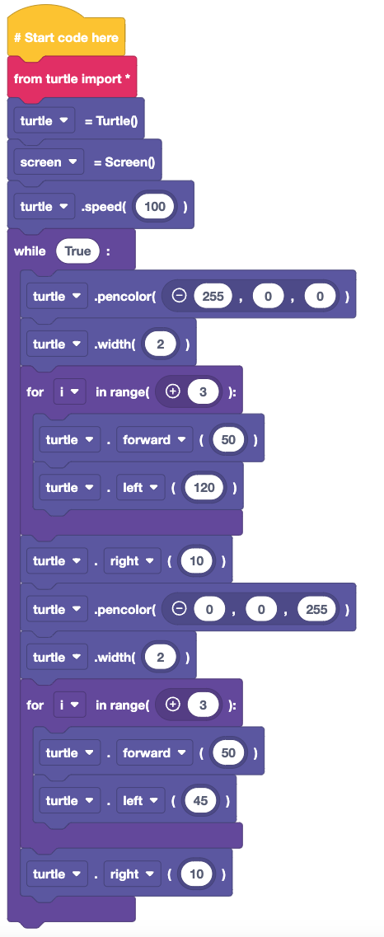
Lesson 2
An example pattern
Here, two loops are used.
The first draws a red triangle at double thickness.
The second draws a blue octagon.
Did you spot the block to increase the speed of the turtle?

Slide 15
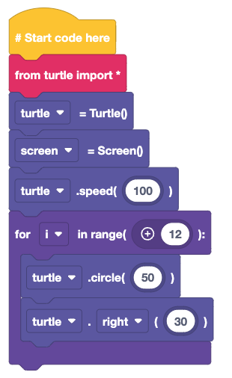
Lesson 2
Drawing a circle
The turtle module has a special block for drawing circles.
It uses the radius to determine the size.
Here we use a for loop to draw a circle pattern

Slide 16
Plenary
What have we learnt?
How to write a sequence to control Turtle
How to use different loops for different actions
How maths is important to create code

Slide 17
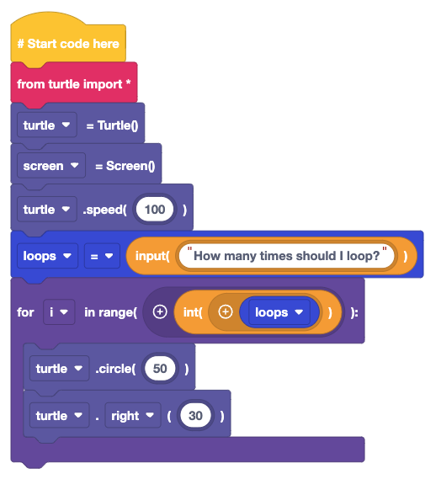
Plenary
Next Lesson
Next Lesson we will use EduBlocks to capture user input and work with different types of data

